Slide 1
File System and Disk Scheduling

Slide 2
File System
An organization of files and directories on disk
OS has one or more file systems
Two main aspects of file systems
Data structures to organize data and metadata on disk
Implementation of system calls like open, read, write using the data structures
Disks expose a set of blocks (usually 512 bytes)
File system organizes files onto blocks
System calls translated into reads and writes on blocks
2

Slide 3
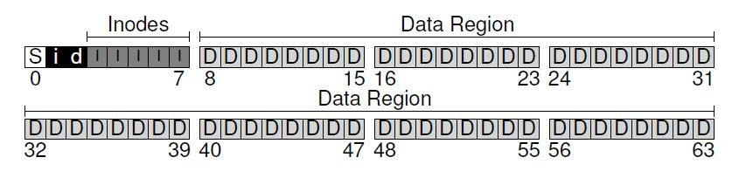
Example: a simple file system
Data blocks: file data stored in one or more blocks
Metadata about every file stored in inode
– Location of data blocks of a file, permissions etc.
Inode blocks: each block has one or more inodes
Bitmaps: indicate which inodes/data blocks are free
Superblock: holds master plan of all other blocks (which are inodes, which are data blocks etc.)
3

Slide 4
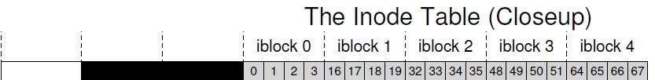
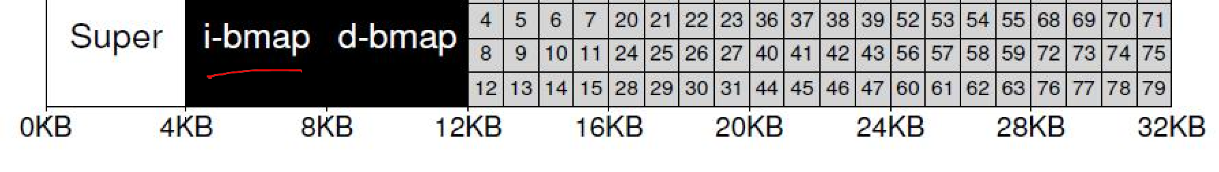
Inode table
Usually, inodes (index nodes) stored in array
– Inode number of a file is index into this array
What does inode store?
File metadata: permissions, access time, etc.
Pointers (disk block numbers) of file data
4

Slide 5
Inode structure
File data not stored contiguously on disk, need to track multiple block numbers of a file
How does inode track disk block numbers?
Direct pointers: numbers of first few blocks are stored in inode itself (suffices for small files)
Indirect block: for larger files, inode stores number of indirect block, which has block numbers of file data
Similarly, double and triple indirect blocks (multi- level index)
5

Slide 6
File Allocation Table (FAT)
Alternate way to track file blocks
FAT stores next block pointer for each block
FAT has one entry per disk block
Entry has number of next file block, or null (if last block)
Pointer to first block stored in inode
6

Slide 7
Opening a file
Why open? To have the inode readily available (in memory) for future operations on file
Open returns fd which points to in-memory inode
Reads and writes can access file data from inode
What happens during open?
The pathname of the file is traversed, starting at root
Inode of root is known, to bootstrap the traversal
Recursively do: fetch inode of parent directory, read its data blocks, get inode number of child, fetch inode of child. Repeat until end of path
If new file, new inode and data blocks will have to be allocated using bitmap, and directory entry updated

Slide 8
Open file table
Global open file table
One entry for every file opened (even sockets, pipes)
Entry points to in-memory copy of inode (other data structures for sockets and pipes)
Per-process open file table
Array of files opened by a process
File descriptor number is index into this array
Per-process table entry points to global open file table entry
Every process has three files (standard in/out/err) open by default (fd 0, 1, 2)
Open system call creates entries in both tables and returns fd number

Slide 9
Reading and writing a file
For reading/writing file
Access in-memory inode via file descriptor
Find location of data block at current read/write offset
Fetch block from disk and perform operation
Writes may need to allocate new blocks from disk using bitmap of free blocks
Update time of access and other metadata in inode

Slide 10
Virtual File System
File systems differ in implementations of data structures (e.g., organization of file records in directory)
Linux supports virtual file system (VFS) abstraction
VFS looks at a file system as objects (files, directories, inodes, superblock) and operations on these objects (e.g., lookup filename in directory)
System call logic is written on VFS objects
To develop a new file system, simply implement functions on VFS objects and provide pointers to these functions to kernel
Syscall implementation does not have to change with file system implementation details

Slide 11
Disk Scheduling
Requests to disk are not served in FIFO, they are reordered with other pending requests
Why? In order to read blocks in sequence as far as possible, to minimize seek time and rotational delay
Who does scheduling? OS does not know internal geometry of disk, so scheduling done mostly by disk controller

Slide 12
Disk Scheduling (Cont.)
Several algorithms exist to schedule the servicing of disk I/O requests
We illustrate them with a request queue (0-199)
98, 183, 37, 122, 14, 124, 65, 67
Head pointer 53

Slide 13
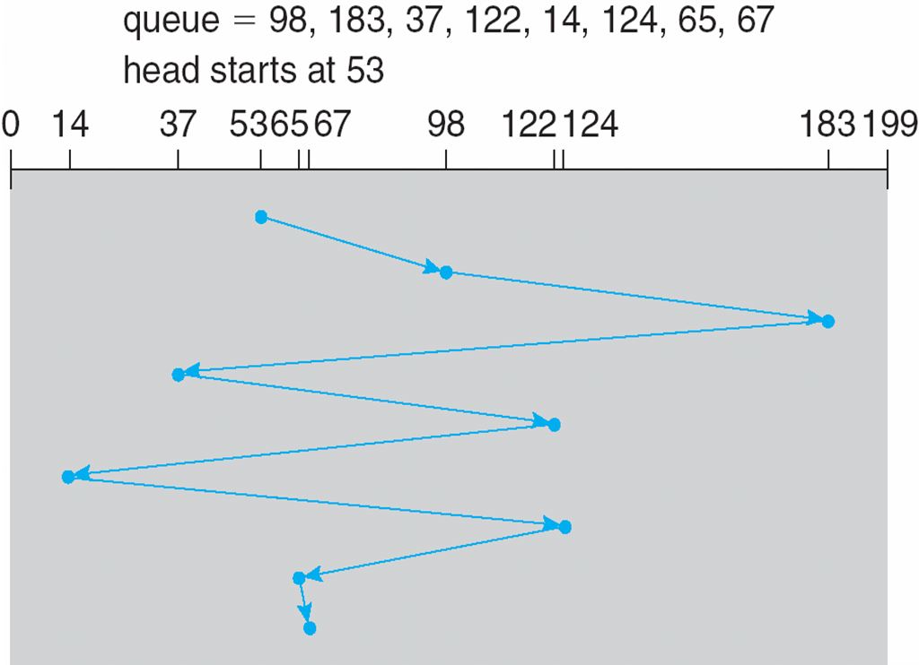
FCFS
Illustration shows total head movement of 640 cylinders

Slide 14
SSTF
Selects the request with the minimum seek time from the current head position
SSTF scheduling is a form of SJF scheduling; may cause starvation of some requests
Illustration shows total head movement of 236 cylinders

Slide 15
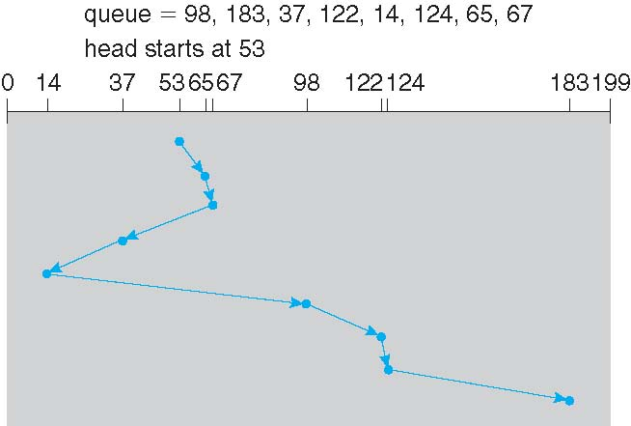
SSTF (Cont.)

Slide 16
SCAN
The disk arm starts at one end of the disk, and moves toward the other end, servicing requests until it gets to the other end of the disk, where the head movement is reversed and servicing continues.
SCAN algorithm sometimes called the elevator algorithm
Illustration shows total head movement of 208 cylinders

Slide 17
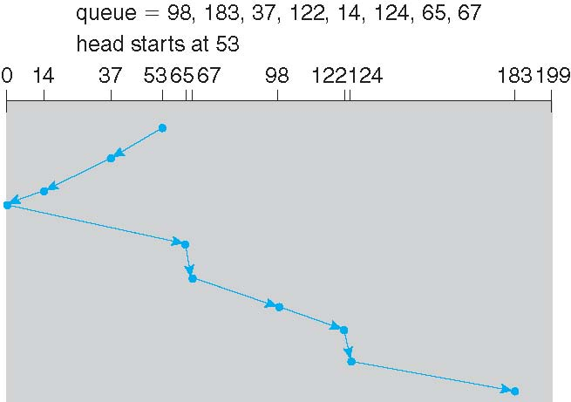
SCAN (Cont.)

Slide 18
C-SCAN
Provides a more uniform wait time than SCAN
The head moves from one end of the disk to the other, servicing requests as it goes
When it reaches the other end, however, it immediately returns to the beginning of the disk, without servicing any requests on the return trip
Treats the cylinders as a circular list that wraps around from the last cylinder to the first one

Slide 19
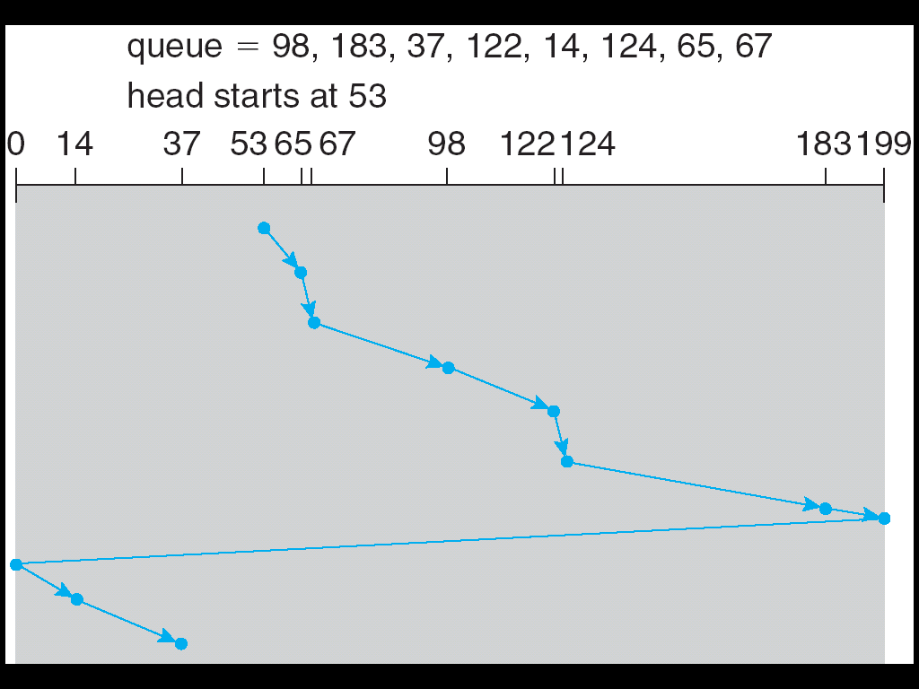
C-SCAN (Cont.)

Slide 20
C-LOOK
Version of C-SCAN
Arm only goes as far as the last request in each direction, then reverses direction immediately, without first going all the way to the end of the disk

Slide 21
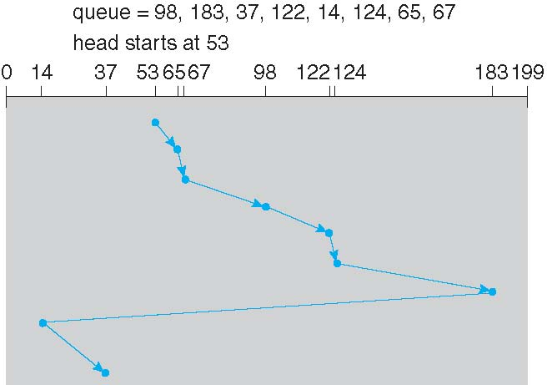
C-LOOK (Cont.)

Slide 22
Thank you!

